Slide 1
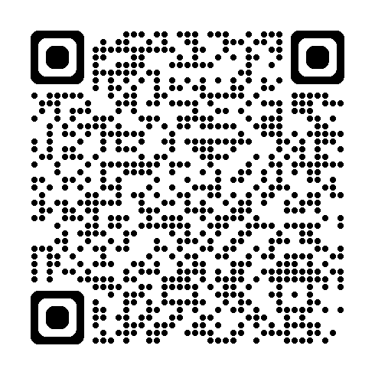
Hearing and Being Heard
Unlock Your Team’s Hidden Potential
Daniel Ward

Slide 2

Team behavior

Slide 3

Does it matter?

Slide 4
Does it matter?
Things we can do

Slide 5
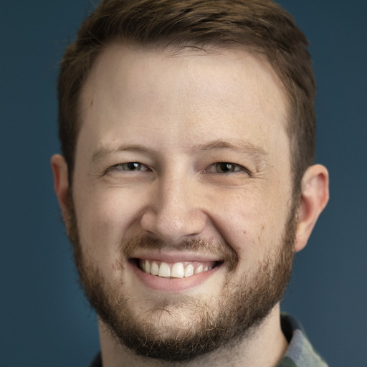







Me
Software developer, consultant
Microsoft .NET MVP
Co-organizer of the San Antonio/Austin .NET User Group
🌐 daninacan.com
@danielwarddev
daniel-ward-dev
danielwarddev.bsky.social

Slide 6
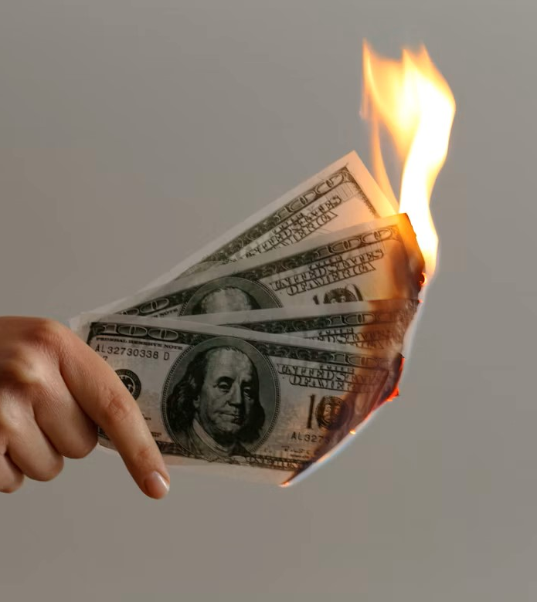
Cost of meetings
Harvard Business Review - $37b/year on meetings in US
https://hbr.org/2018/02/how-to-fix-the-most-soul-crushing-meetings?utm_medium=social&utm_campaign=hbr&utm_source=twitter&tpcc=orgsocial_edit
Otter.ai – up to $2.5m savings for a 100-person company
https://20067454.fs1.hubspotusercontent-na1.net/hubfs/20067454/Report_The%20Cost%20of%20Unnecessary%20Meeting%20Attendance.pdf

Slide 7
Does it matter?

Slide 8
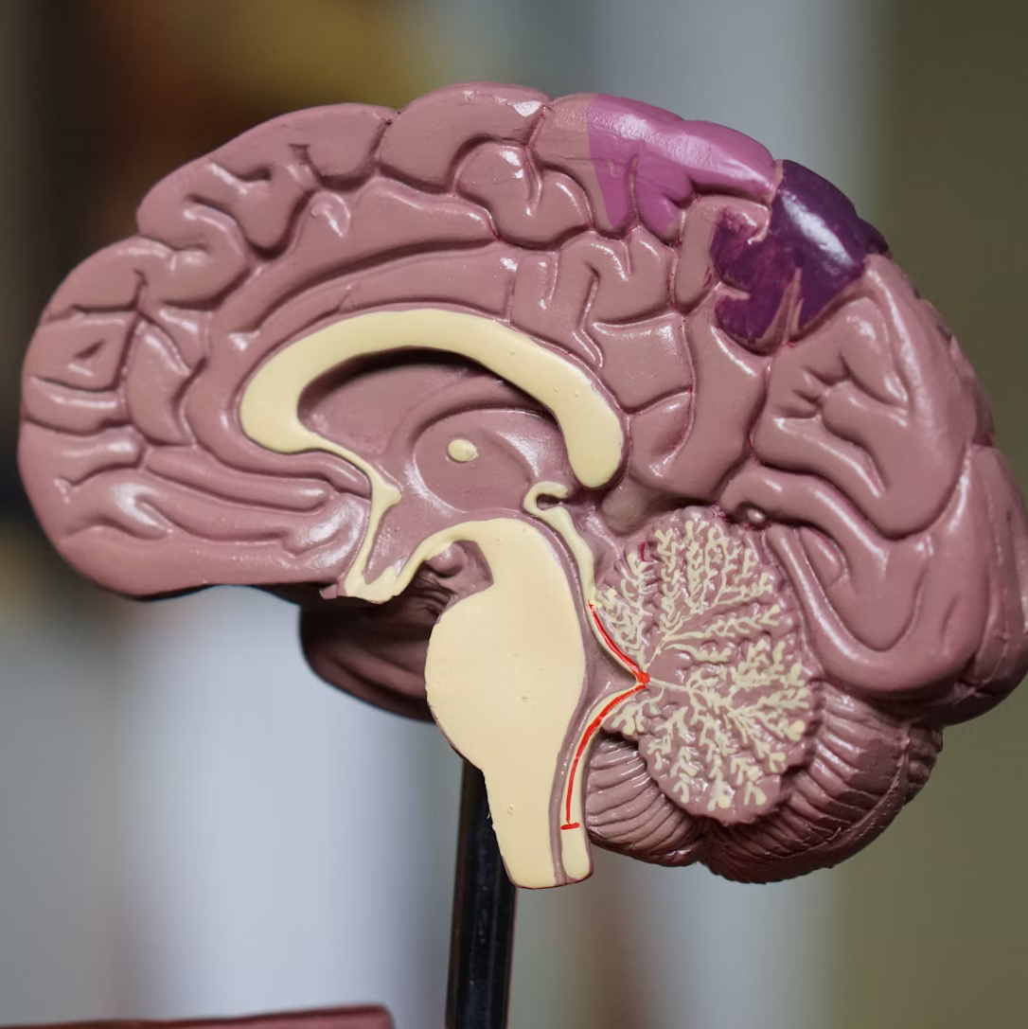
Predicting Performance
2008, Anita Woolley et al
Collective intelligence
3 main factors

Slide 9
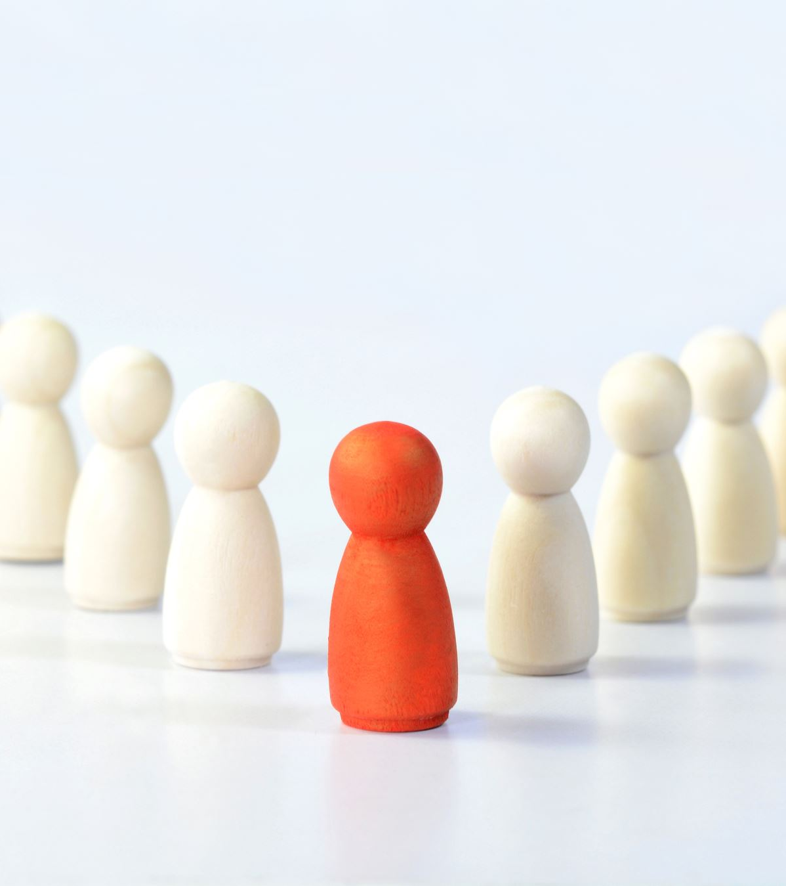
NOT main factors
Individual IQ
Highest IQ
Leader’s IQ

Slide 10
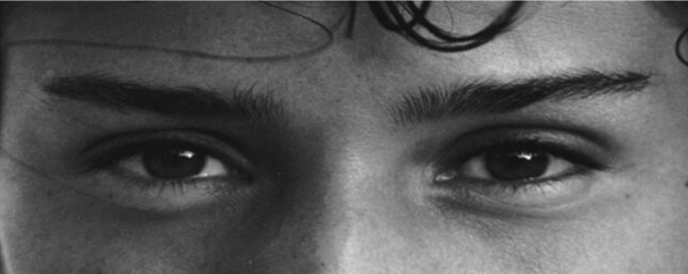
1. Social Sensitivity
Reading the Mind in the Eyes
Playful Comforting Irritated Bored
Notes:
Fun fact – invented by Simon Baron-Cohen in 1997, cousin to Sacha Baron Cohen

Slide 11

2. Distribution of conversational turn taking

Slide 12

3. Number of women

Slide 13

Project Aristotle
Google, 2012
Julia Rozovsky
What makes an effective team?

Slide 14

Psychological safety
Amy Edmonson, 1999
Can safely share ideas without ridicule
Doesn’t mean comfort, agreement, or lower standards
Does mean culture of learning, risk taking

Slide 15
What makes an effective team?
1. Psychological safety. “If I make a mistake on our team, it is not held against me.”
2. Dependability. “When my teammates say they’ll do something, they follow through with it.”
3. Structure and Clarity. “Our team has an effective decision-making process.”
4. Meaning. “The work I do for our team is meaningful to me.”
5. Impact. “I understand how our team’s work contributes to the organization's goals.”

Slide 16
The Main Point
Social sensitivity and balanced conversation are highly indicative of group performance
How can we foster these things in our teams?

Slide 17
People differences

Slide 18
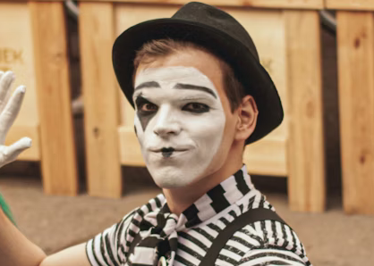
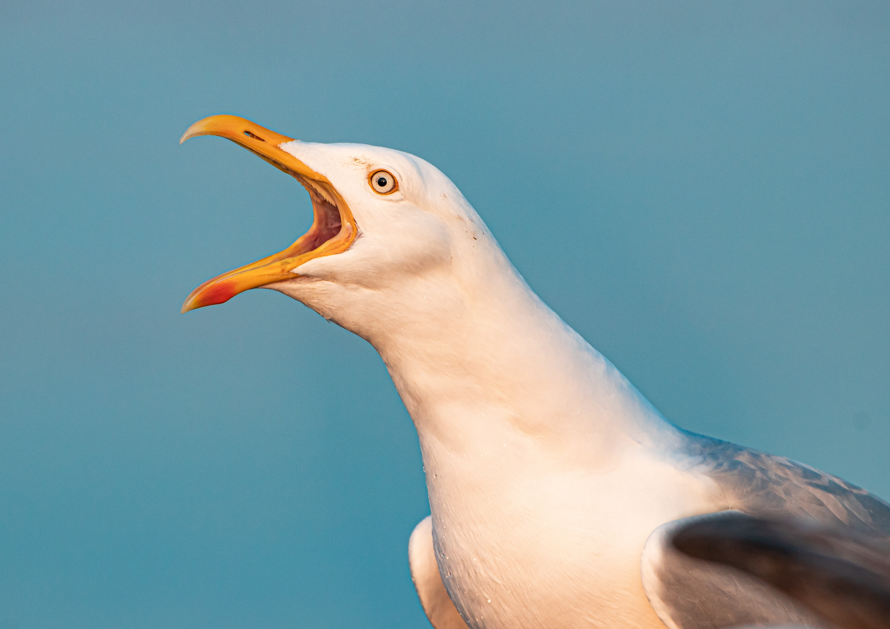
Team participation
Conversation
Talk a little
Talk a lot

Slide 19
Team participation
🤖
Goal isn’t to have everybody at the same point
Case-by-case, empathy
🧛‍♂️
No silver bullets
🧺
Laundry list, not checklist

Slide 20
Why do they act that way?
Just like that naturally
Differences in thought processing
Different motivations

Slide 21

Talk a little
They know less; newer
Ask directly
Team too big?
Boring meetings?
Happy in role?

Slide 22

Talk a lot
They know more; experienced
Knowledge silos!
Culture of competition
Awkward silences
Try muting

Slide 23
Things we can do

Slide 24
Cheating it - meeting formats
Instead of… | Try…
What’s your opinion on this? | Are we forgetting anything? Is anything not clear?
Why does this issue keep happening? | What do you make of this issue? How else could we handle this?
What can we improve? | If you had a magic wand and could change one thing about the way you work, what would it be?
Can we do x instead? | Can we try x for a week?
Ask specific/open questions
Silent sorting
Non-anonymous cards
Switch up meeting formats
retromat.org

Slide 25
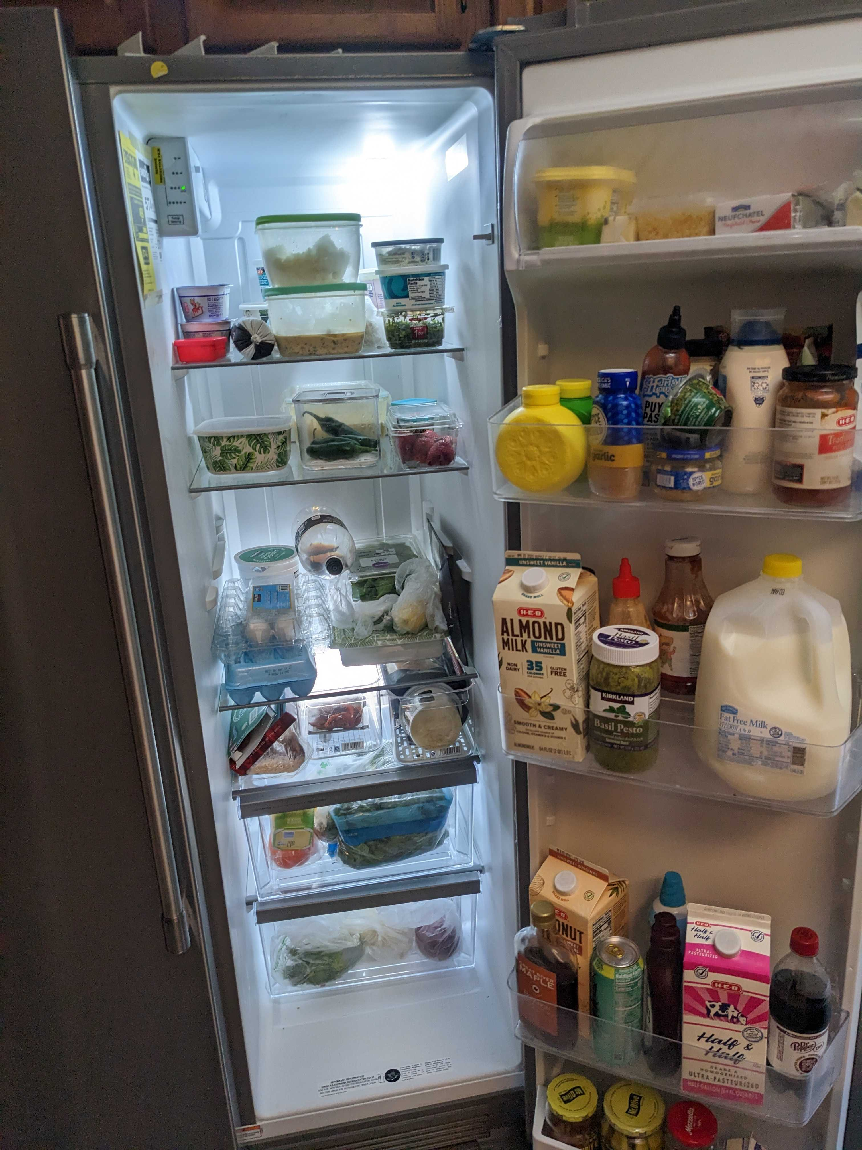

Slide 26
Silent sorting exercise
2 minutes
Move cards into the bucket you think they belong in
A card can be moved more than once

Slide 27

Outside influences
Burnout
Boreout
Owning the work
Interviewing & hiring process

Slide 28

Leadership
People will mimic leaders
⭐ What happens when team members voice their opinions or bring up a new idea?

Slide 29

Culture of competition
Competitive workplace
Generally lowers collective intelligence
Competition itself is not necessarily bad

Slide 30

Mentorship
Applies to both kinds of people
Helps the mentee to learn, acclimate
Helps the mentor to give space to succeed
Helps solve curse of knowledge

Slide 31

Cognitive diversity
Higher collective intelligence
More fun, rewarding, effective
Cross-functional teams!

Slide 32

Jellyfish Rule
Whole team has to agree to do it!
1. Safe
2. Accessible
3. Raises awareness
Make it your own

Slide 33
Context switching
Switching to a different task
Average of 23 minutes to regain focus after a distraction
https://ics.uci.edu/~gmark/chi08-mark.pdf
Students who context switched a lot had significant issues with their academic work
https://web.archive.org/web/20130403072124/http://reyjunco.com/wordpress/pdf/JuncoMultitaskingCHB2012.pdf

Slide 34
Context switching exercise
Make two columns separated by a line
In one column, write down the letters A through J
In the other, write down roman numerals I through X
Do it one at a time, then again, alternating

Slide 35
A
B
C
D
…
I
II
III
IV
…

Slide 36

Pairing
Or mobbing/swarming
Addresses most of this presentation
Harder to compete, less meetings, more fun, etc.
Can be draining, some people may not get along

Slide 37
Rumsfeld Model
Known knowns
Known unknowns
Information we know of
Information we know we lack
Information we ignore/are biased towards
Information we are completely unaware of
Unknown knowns
Unknown unknowns

Slide 38

Work outside of your space!
Better cognitive diversity
Cross-functional teams
More fun and rewarding

Slide 39
Yourself!
Golden rule: have empathy
01
Evaluate your own participation
02
Show others you’re paying attention, don’t interrupt
03
Ask for feedback, invite team to challenge your perspectives
04

Slide 40
Closing thoughts
Social sensitivity and balanced conversation are very important for group performance
Best way to figure out what’s wrong is to get to know people
Ask what we can do better
Pairing/mobbing covers a multitude of sins
Does your team have time to get work done?

Slide 41

Suggested stuff/further reading
Google’s Project Aristotle
Anita Woolley, collective intelligence
Reading the Mind In the Eyes test (~5 mins)
The Right Way to Cut People Off in Meetings
Collaborative Culture or Competitive: Which Is Best for Business?
Coaching Agile Teams, Lyssa Adkins

Slide 42
Thank you!
Daniel Ward
🌐daninacan.com
@danielwarddev
daniel-ward-dev
danielwarddev.bsky.social

